Slide 1
Efficient Probabilistic Logic Reasoning with Graph Neural Networks
Boyuan He
Haochen Li
Jingyue Shen

Slide 2
Schedule
Background - knowledge graph & MLN
Motivation
Model
Experiment

Slide 3
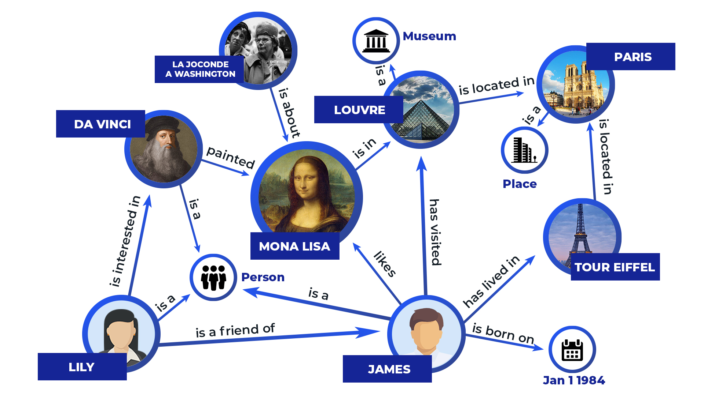
Knowledge Graph

Slide 4





Knowledge Graph
Knowledge Graph is a tuple
-- set of entities/constants
-- set of relations/predicates
-- set of observed facts

Slide 5







Knowledge Graph
Predicate is a logic function
-- have relation with (asymmetric)
Ground predicate is predicate with a set of entities assigned
-- assignment ( → )
ground predicate ≡ binary random variable
Observed fact is truth value {0, 1} assigned to a ground predicate

Slide 6
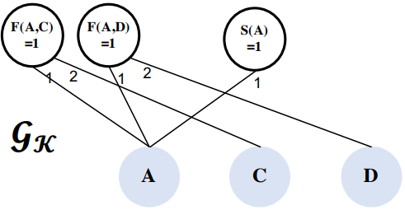
Knowledge Graph
knowledge base represented by a bipartite graph
-- constant
-- observed facts (factor)
-- a set of edge

Slide 7

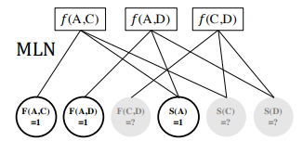
Markov Logic Networks
MLNs use logic formulae to define potential functions in undirected graphical models
logic formulae -- defined by composition of predicates
Example

Slide 8



Markov Logic Networks
MLN can be represented as a joint distribution over all observed facts O and unobserved facts H
-- observed facts, -- unobserved facts
-- assignment (similar to KG)
-- entire collection of consistent assignments
- potential function defined by a formula
-- confidence score of formula
-- partition function summing over all ground predicates
Notes:
One form of φf (·) can simply be the truth value of the logic formula f. For instance, if the formula is f(c, c0 ) := ¬S(c)∨¬F(c, c0 )∨S(c 0 ), then φf (c, c0 ) can simply take value 1 when f(c, c0 ) is true and 0 otherwise

Slide 9
KG vs MLN
Knowledge graphs | MLN
Sparse Number of edges linear to the number of entities | Denser number of edges high-order polynomials to the number of entities number of nodes can be quadratic or more to the number of entities

Slide 10
Motivation
Markov Logic Network
Pros:
1) Incorporate logic rules as prior knowledge
2) Allow MLN to generalize in tasks with small amount of labeled data
Cons
Inference in MLN is computationally intensive

Slide 11
Motivation
GNN-based methods
Pros:
1) Can achieve good performance with sufficient labeled data
Cons
1) Long-tail nature of knowledge graph leads to data scarcity problem among long-tail relations
long-tail property: a large portion of the relations in only a few triplets.

Slide 12
Model
A method which is data-driven yet can still exploit the prior knowledge encoded in logic rules.
Use a self-designed GNN as the inference module to make MLN’s inference efficient

Slide 13
Model
MLN - trained with variational EM framework
E-step (inference)
M-step (learning)
Use GNN to approximate the posterior distribution P(H|O)

Slide 14



Optimization objective for MLN
Instead of optimizing the log-likelihood of all the observed facts
Optimize the variational evidence lower bound (ELBO) of the data log-likelihood:
-- variational posterior distribution of the latent variables
-- joint distribution modeled by MLN

Slide 15
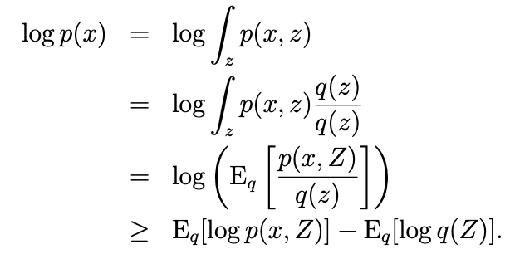
Derivation of lower bound
f(E[X]) >= E[f(X)] (Jensens Inequality)

Slide 16
Variational EM framework for MLN
M-step: learn the weights of the logic formulae in MLN, where Q_{θ} is fixed and P_{w} is optimized to maximize the data log-likelihood
E-step: Infer the posterior distribution of the latent variables, where P_{w} is fixed and Q_{θ} is optimized to minimize the KL divergence between Q_{θ} (H|O) and P_{w} (H|O)

Slide 17


Variational EM algorithm E-step
Use mean-field variational distribution to approximate the posterior distribution, each unobserved ground predicate inferred as follows:
-- factorized distribution (follow bernoulli distribution)
is parameterized using ExpressGNN
More about variational inference: https://www.cs.cmu.edu/~epxing/Class/10708-17/notes-17/10708-scribe-lecture13.pdf

Slide 18

Variational EM algorithm E-step
After parameterization, can be rewritten as:

Slide 19
Variational EM algorithm E-step
Problem: intractable computational cost
Solution:
The author uses mini-batches of ground formulae
In each optimization iteration
Sample a batch of ground formulae
For each formulae sampled, compute the objective w.r.t involved latent variables
Sum over all formula and all possible assignment
Sum over all assignments to latent variables

Slide 20
Variational EM algorithm E step
If the task have sufficient label data, add supervised learning objective to enhance the inference network
It is complementary to ELBO on predicates that are not well covered by logic rules but have enough observed facts
And the overall objective function is

Slide 21



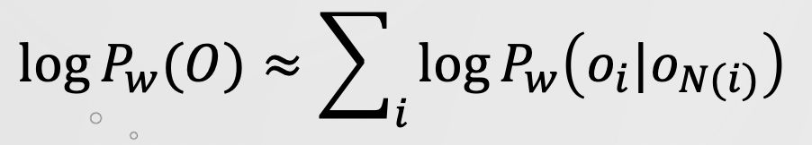


Variational EM algorithm M step
learn the weights of logic formulae in MLN with fixed
is no longer a constant, and has exponential number of terms, so is intractable to directly optimize the ELBO
Use pseudo-log-likelihood:
The optimization goal becomes:
-- Makarov blanket of

Slide 22



Variational EM algorithm M step
For each formula that connects to its Markov blanket, optimize weight
Use gradient descent, with the derivative:
= 0 or 1, if is observed fact
= , otherwise

Slide 23
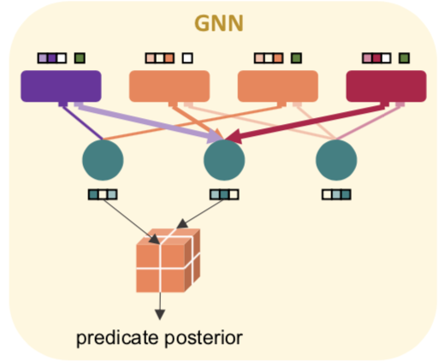
ExpressGNN
Need to have a expressive and efficient network to approximate true posterior distribution in step E
ExpressGNN involve three parts:
Vanilla graph neural network (GNN)
tunable embeddings
uses the embeddings to define the variational posterior

Slide 24
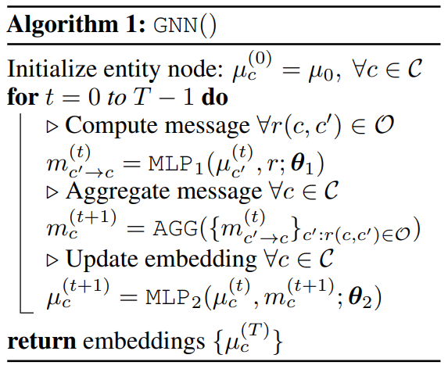



Step 1: Vanilla GNN
Build a GNN on the knowledge graph , which is much smaller than MLN.
Parameters are shared across the entire graph and independent of # of entities
The GNN is a compact model with parameters given d dimensional embeddings

Slide 25



Step 2: Add tunable weights
For each entity in the KG, augment its GNN embedding with a tunable embedding ---- as
The tunable embeddings increase the expressiveness of the model
Number of parameters in tunable embeddings is

Slide 26


Step 3: Calculate posterior
variational posterior defined as:
number of parameters in is

Slide 27

ExpressGNN
Compact GNN assigns similar embeddings to similar entities in the KG
Expressive tunable embeddings allows encoding of entity specific information beyond graph structures
Overall number of trainable parameters is , and by controlling d and k, we can control the trade-off between compactness and expressiveness

Slide 28
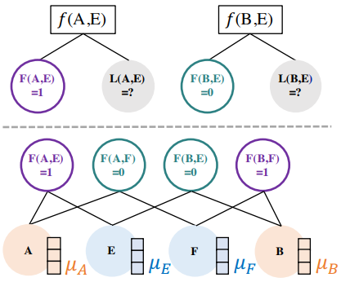



Why we need the tunable embedding
Vanilla GNN produces the same embedding for some nodes that should be distinguished
for example given two predicates (Friend: F(·, ·), Like: L(·, ·)), and one formula (F(c, c′ ) ⇒ L(c, c′ )):
A and B have opposite relations with E, but GNN will produce same embedding
and have different posteriors, but they get same
ExpressGNN avoid this problem by allowing additional tunable embeddings

Slide 29
ExpressGNN
Efficient: works on the knowledge graph, instead of the huge MLN grounding graph, more efficient than the existing MLN inference methods
Compact: the GNN model with shared parameters can be very memory efficient
Expressive: the GNN model can capture structure knowledge in the knowledge graph, and the tunable embeddings can encode entity-specific information
Generalizable: with the GNN embeddings, ExpressGNN may generalize to new entities or even different but related knowledge graphs

Slide 30
Experimental Setup
Benchmark datasets
UW-CSE , Cora, synthetic Kinship datasets, and FB15K-237
General settings
Linux machine with RTX 2080 Ti, Intel Xeon Silver 4116 and 256GB RAM
Hyperparameters:
use 0.0005 as the initial learning rate, and decay it by half for every 10 epochs without improvement
two-layer MLP with ReLU activation function for each embedding update step
MLP parameters is different for steps, edge types and direction of embedding aggregation
...

Slide 31
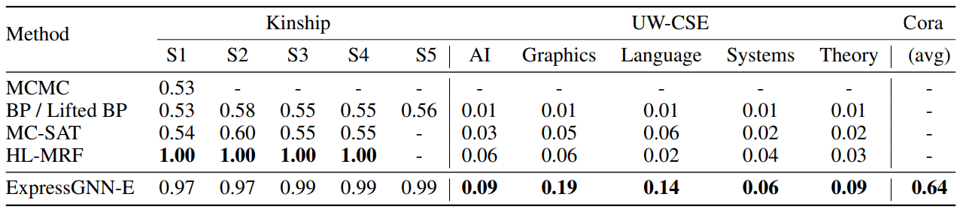
Experiment Result

Slide 32
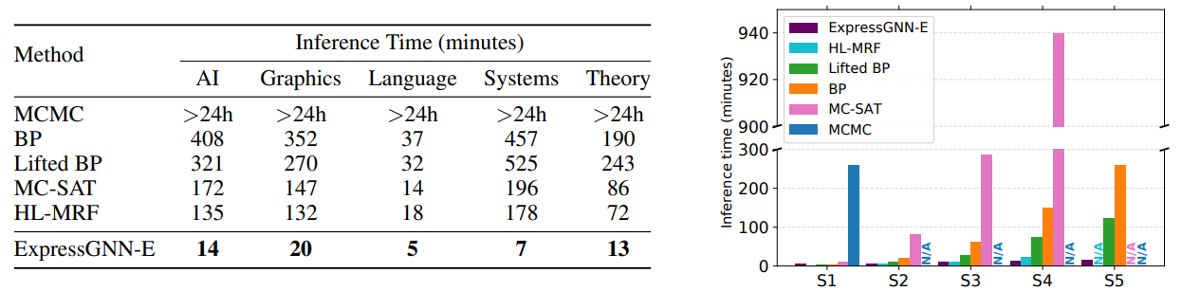
Experiment Result

Slide 33
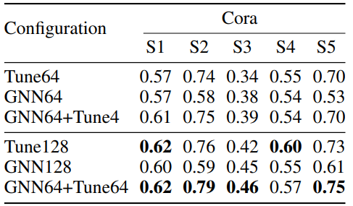
Experiment Result

Slide 34
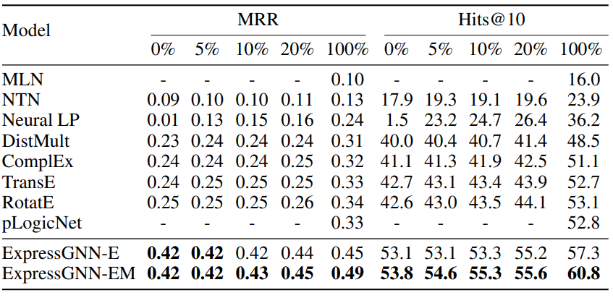
Experiment Result

Slide 35
Demo

Slide 36
Quiz
1. What is a potential problem for applying GNN-based methods on knowledge graphs? (single choice)
a. There is no potential problem. GNN can perform well on all graph-related problems.
b. Long-tail nature of Knowledge Graph makes applying GNN hard since GNN requires sufficient labeled instances to achieve good performance.
c. Unobserved features in Knowledge Graph could never be learned by any neural network through any means.
2. Which of the following is true about Markov Logic Network(MLN)? (single choice)
a. Inference in MLN is computationally intense.
b. The MLN structure is normally sparser than knowledge graph
c. a and b
3. In regards to ExpressGNN, at which step is the GNN used in variational EM for Markov Logic Network(MLN)? (single choice)
a. E step
b. M step

Slide 37
Questions

